Slide 1
Product Analyst Challenge
Kamilla Valeeva

Slide 2


Task 1. Explorative Analysis
I used Python (pandas library) to get familiar with the dataset and perform some data cleaning:
import pandas as pd
xls = pd.ExcelFile(r"C:\Users\never\Downloads\claims_provider_data_anonymized.xlsx")
claims = pd.read_excel(xls, "data_claims_anonymized")
provider = pd.read_excel(xls, "data_provider_anonymized")
shape – attribute, returns a tuple representing the dimensionality of the DataFrame.
info() – method, prints a concise summary of a DataFrame.
describe() – method, generates descriptive statistics that summarize the central tendency, dispersion and shape of a dataset’s distribution, excluding NaN values, analyzes both numeric and object series

Slide 3
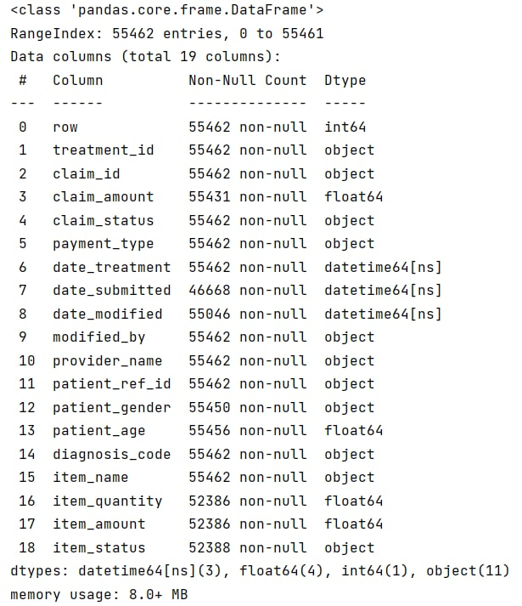
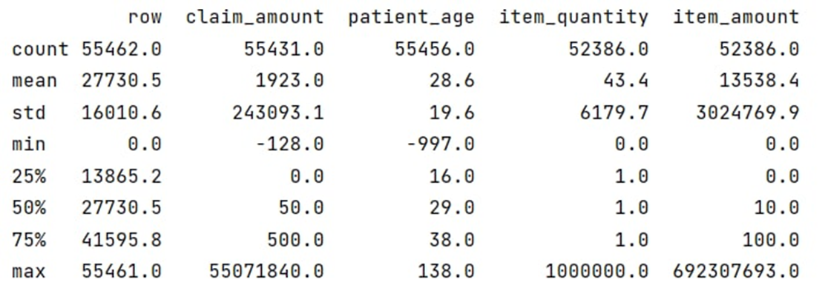
Claims dataframe
claims.info()
print(claims.describe())
All claims_amount negative values were only 0,02% of all values and all were with claim_status = ‘Rejected’ so I did not do anything with that.
print(claims.shape)

Slide 4
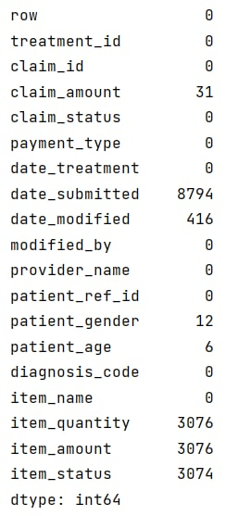
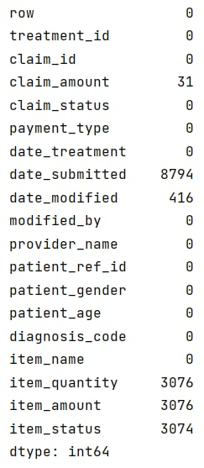
Claims data cleaning
I found 12 missing values in column patient_gender, so decided to replace it with “No Gender” string value to avoid nulls in data using fillna function:
claims.isnull().sum()
claims["patient_gender"].fillna("No Gender", inplace=True)
There were also found 6 missing values in column patient_age, so those were replaced by the median value using fillna function:
claims["patient_age"].fillna(claims["patient_age"].median(), inplace=True)
Finally, I have found some negative values in column patient_age, so those were replaced by the median value using lambda-expression:
claims['patient_age'].apply(lambda x: x if x > 0 else claims["patient_age"].median())

Slide 5
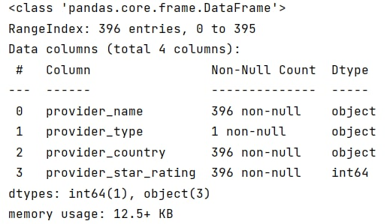
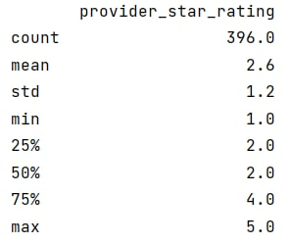
Provider dataframe
provider.info()
print(provider.describe())
print(provider.shape)

Slide 6

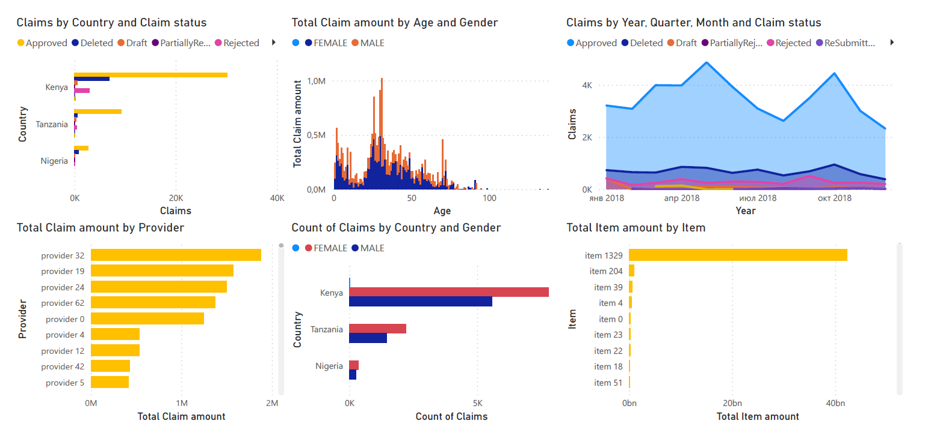
Power BI Dashboard

Slide 7
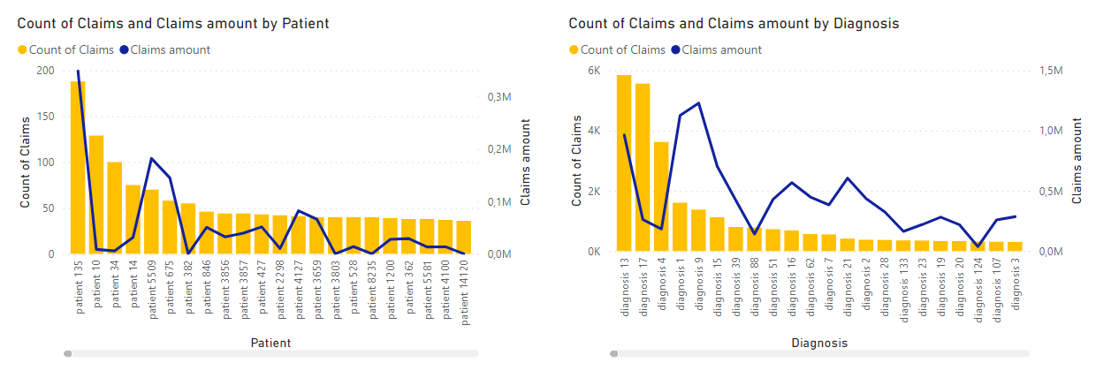
Power BI Dashboard

Slide 8
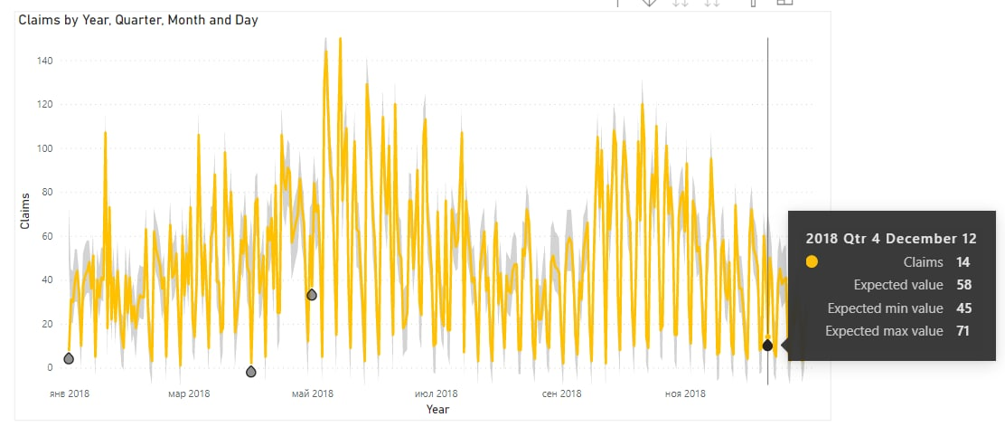
Power BI Dashboard

Slide 9

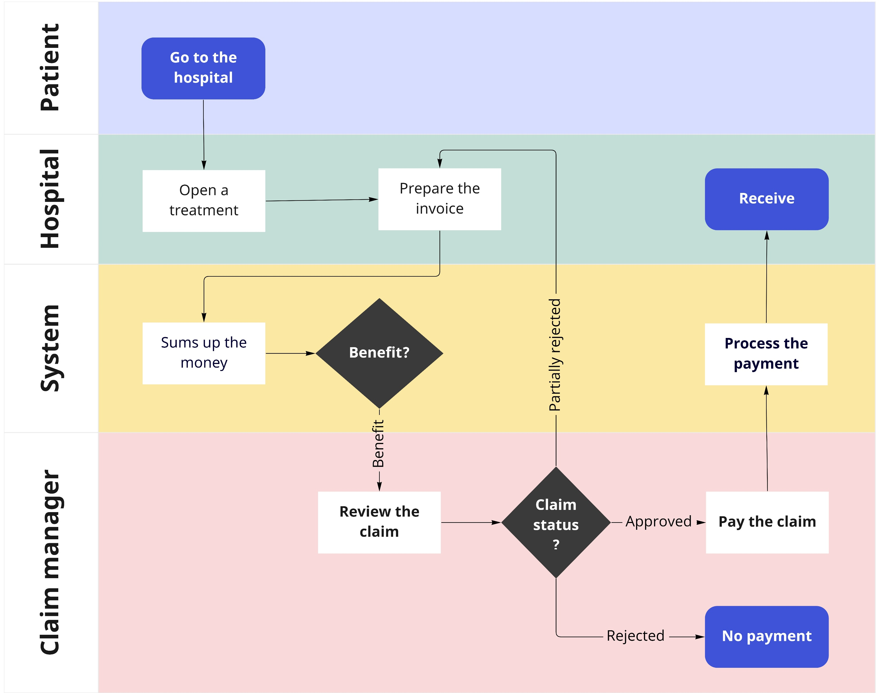
Claim process visualization

Slide 10

SQL queries
What are the top 5 most expensive items (on average) for Kenyan providers?
SELECT top 5 item_name,
average_amount = round(avg(item_amount*item_quantity), 1)
FROM dbo.data_claims c
JOIN dbo.data_provider p ON c.provider_name = p.provider_name
AND p.provider_country = 'Kenya'
WHERE item_status not in ('DELETED')
AND item_status IS NOT NULL
AND item_quantity > 0
AND claim_status not in ('Deleted')
GROUP BY item_name
ORDER BY avg(item_amount*item_quantity) DESC
joined tables claims and provider by the column provider_name
applied filtering by provider_country in the JOIN clause
filtered resulting data by removing values DELETED in columns items_status and claim_status, by removing values NULL in column item_status and removing 0 values in column item_quantity
selected top 5 item names and average of multiplication of item_amount and item_quantity
sorted the data in descending order

Slide 11
SQL queries
How many claims have been approved by 5-star rated Nigerian providers?
SELECT count(DISTINCT claim_id)
FROM dbo.data_claims c
JOIN dbo.data_provider p ON c.provider_name = p.provider_name
AND p.provider_country = 'Nigeria'
AND provider_star_rating = 5
WHERE claim_status = 'Approved'
joined tables claims and provider by the column provider_name
applied filtering by provider_country and provider_star_rating in the JOIN clause
filtered resulting data by claim_status in the WHERE clause
selected count of distinct claim_id values

Slide 12
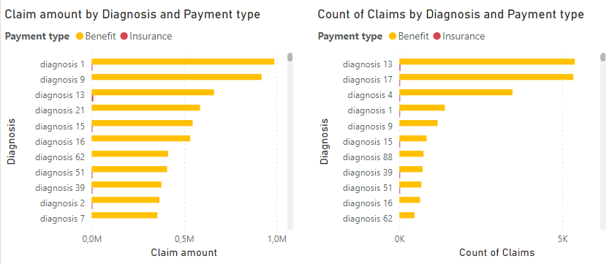
Task 2. Payer suggestions
While performing different visuals in Power BI, I have noticed that most popular approved cases were related to some specific diagnoses: diagnosis 1, 9, 13, 17.

Slide 13
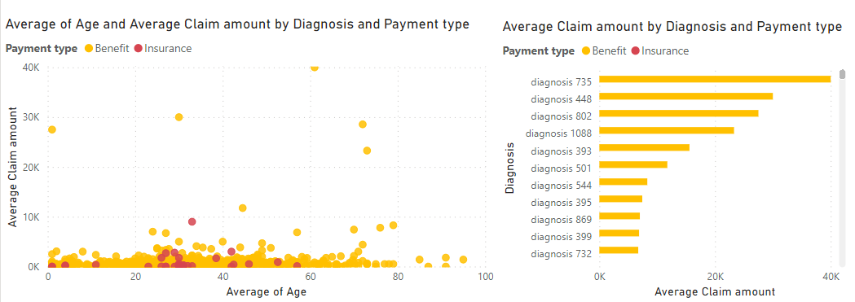
Task 2. Payer suggestions
However, these diagnoses are not the most expensive ones (above 20K): diagnosis 735, 448, 802, 1088

Slide 14
Task 3. CarePay suggestions

Slide 15
Task 4. Work plan

